Slide 1

CMPICA CHARISAT
2023
CA217 MPPL
Case Study
P y t h o n S cr ap p i n g G U I B as e d A p p l i cat i o n
21BCA008 Pratham Rathod

Slide 2



Requires Modules
2023
Tkinter pandas
Requests
bs4 PIL
json
webbrowser datetime
docx
Page 2

Slide 3



Functionality
2023
Scrape Image & Text From Wikipedia Collect Stock Market data From NSE
Download n number of images that client want Collect Search result like google
Give News on any topic
Convert data into Word or Excel File
Page 3

Slide 4

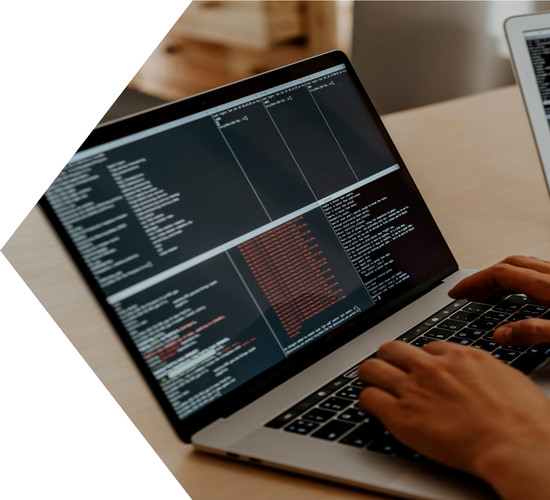
Let's Know More About
Wikipedia Section...
Learn More
Page 4

Slide 5

Structure of Wikipedia
Screen
Class wiki()
init (root)
creating root , Frame,
title, heading
main_win()
search()
save_doc()
creating title, Entry Box, Search Button
collection data from Internet, Insert TextArea, Buttons
Create Word File That Have
Image and Text
Page 5

Slide 6

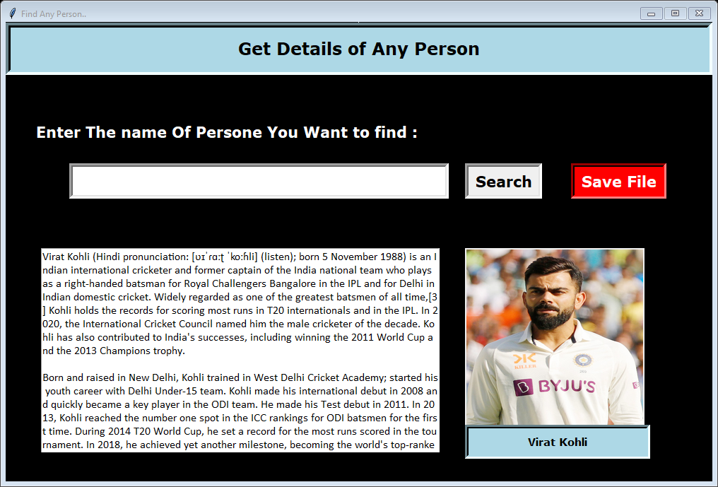

2023
Screen Of Wikipedia
Page 6

Slide 7





Structure of Share Market
Screen
Class stock()
display_c o()
init (root)
collect_data ()
Collect The Data From Insertnet & display in table
save_exc()
creating root , Widgets, Variables
Display The Information Company wise
Create Excel File That Have
All Data
Page 7

Slide 8
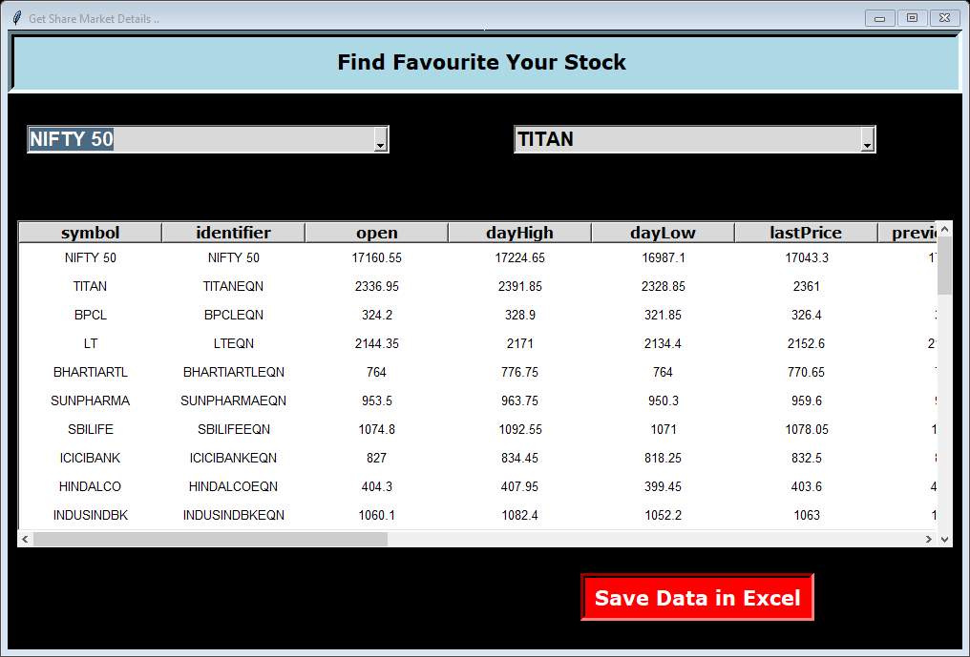
Screen Of Share Market
2023
Page 8

Slide 9









Structure of Search
Screen
Class web()
init (root)
download_ img()
img_search()
web_search()
news_search()
open_brows er()
get_weblinks()
get_newslinks()
Page 9

Slide 10
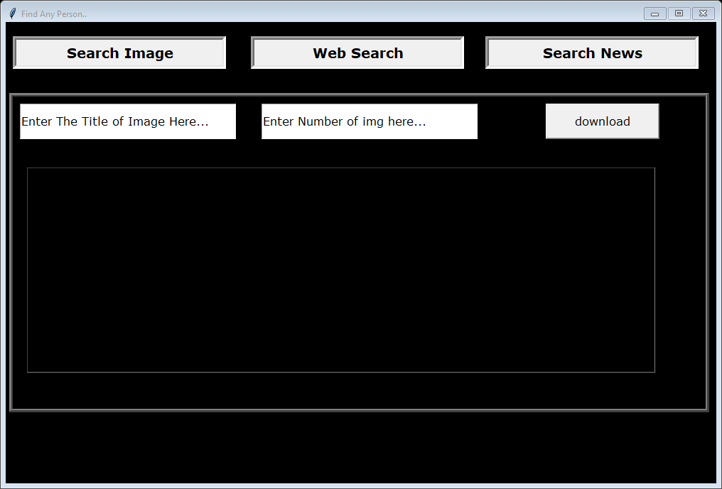
2023
Screen Of Search
Page 10

Slide 11
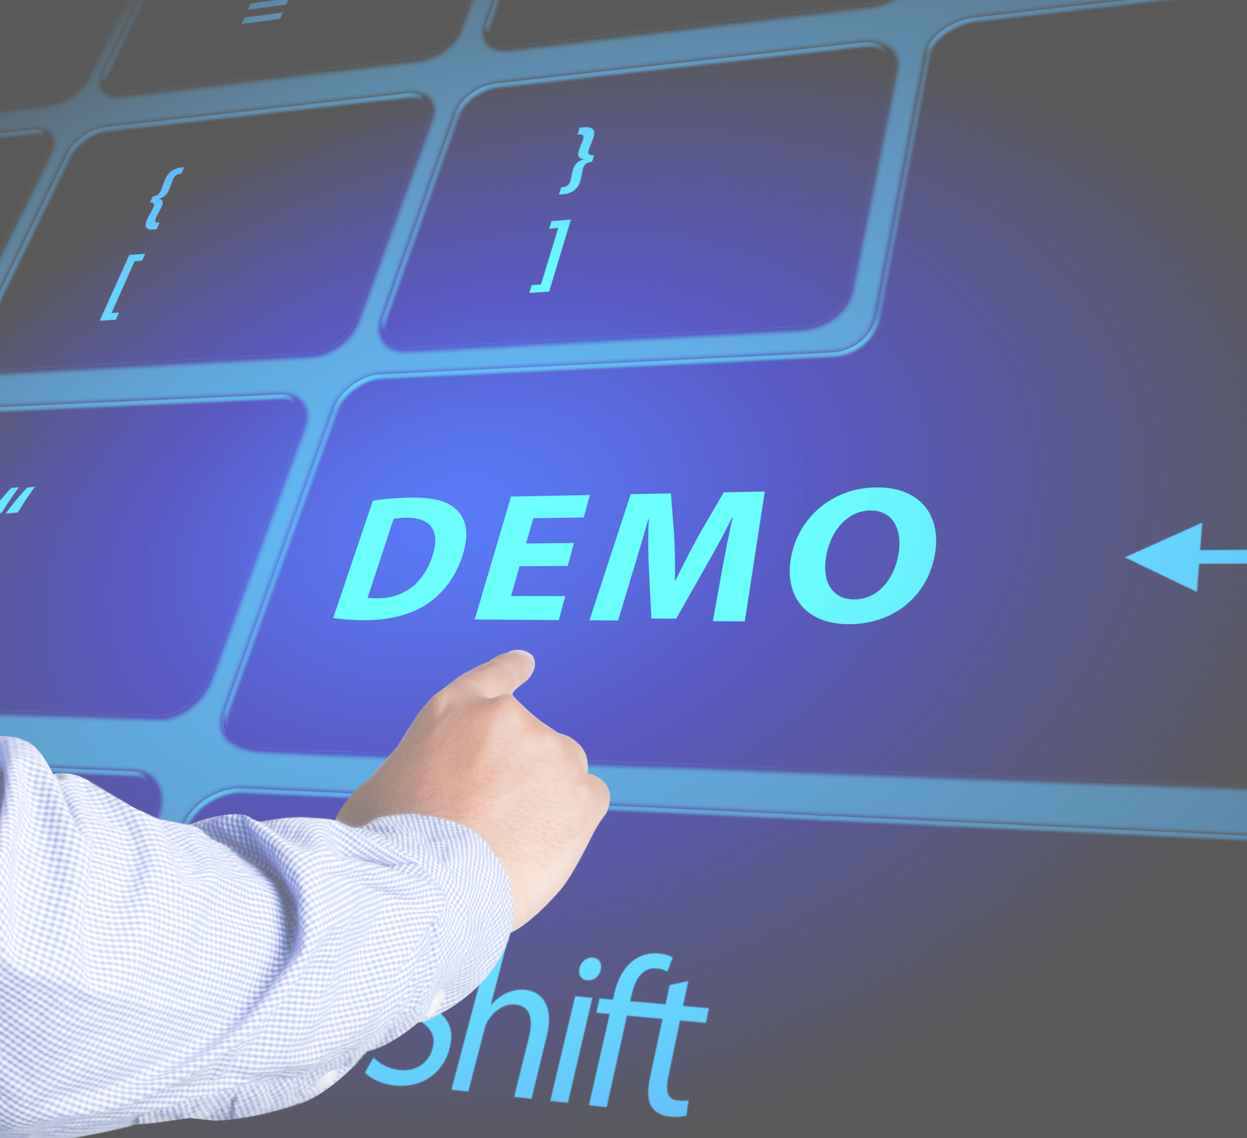


Let's Have Demo..

